Slide 1
Where are the HIV positives in Kenya? Unmasking testing yield in a spatial context
Anthony Waruru
Division of Global HIV &TB, U.S Centers for Disease Control and Prevention (CDC), Nairobi, Kenya
&
Centre for International Health, University of Bergen, Norway

Slide 2
Where are the HIV positives in Kenya? Unmasking testing yield in a spatial context
The UNAIDS 90-90-90 Fast-Track targets provide a framework for assessing coverage of HIV testing services (HTS), linkage to care, and viral load suppression.
In Kenya the bulk of HTS is aligned to the 5 highest HIV-burden counties: Nairobi, Homabay, Kisumu, Siaya, and Migori
Is it true then that high yielding sites (i.e. those identifying high numbers of new infections) are in these counties?
Geospatial analyses, can help in location-focused HTS planning to increase diagnosis of PLHIV and reach the “first 90”.

Slide 3
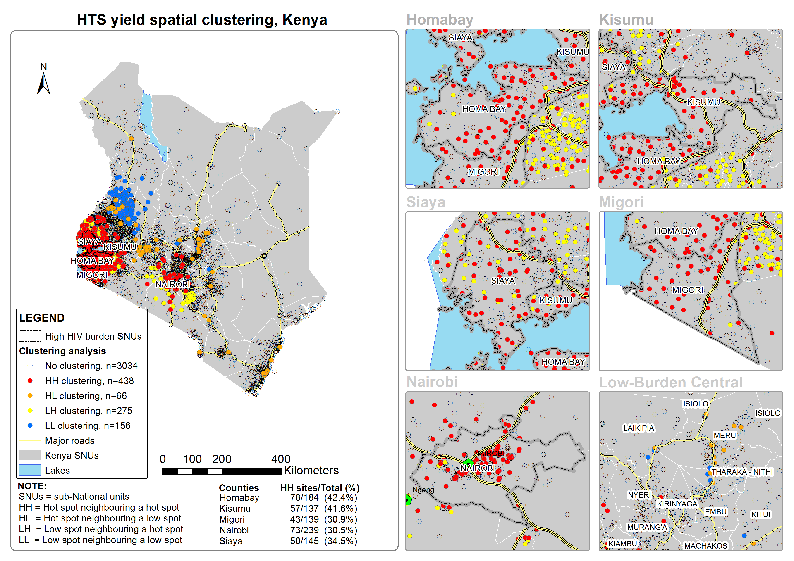
Methods and Results
Data: Routine site-level HTS data in Kenya
HTS yield was in absolute numbers
Moran's Index (Moran’s I) used to assess spatial autocorrelation of HTS yield by site & locality.
Spatial distribution of HTS yield in Kenya and in 5 high HIV-burden counties, 2016
Most sites showed no-clustering (3034, 76.4%); clustering was as follows: HH (438, 11.0%), HL (66, 1.7%), LH (275, 6.9%), and LL (156, 3.9%).
Of the HH sites, 301 (68.7%) were in high HIV-burden SNUs

Slide 4
Take home messages
High HIV-burden SNUs contain most high yielding sites.
137(31.3%) of the high yielding sites lie in low burden SNUs
Access to HTS is needed everywhere in Kenya, yet, targeting is difficult in low prevalence areas.
Geospatial analyses help to define hotspots and priority areas for enhanced HTS
Using this information, it is possible to spatially refine targeting and achieve the “first 90”.

Slide 5
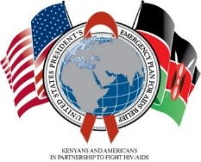
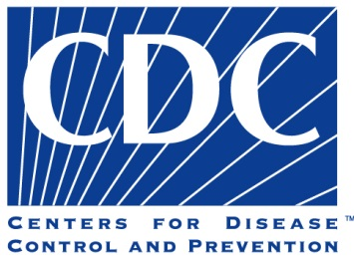

Acknowledgements
This poster was supported by U.S. President's Emergency Plan for AIDS Relief (PEPFAR) through the U.S. Centers for Disease Control and Prevention under the terms of grant #GH001953. The findings and conclusions are those of the author(s) and do not necessarily represent the official views of the funding agencies.
Ministry of Health

